Slide 1
PROBLEM STATEMENT:
R PROGRAMMING PROJECT
SENTIMENT ANALYSIS FOR SOCIAL MEDIA
Natural Language Processing (NLP) for Sentiment Analysis:-Implement NLP techniques to analyze sentiment in text data. Apply sentiment analysis to social media, customer reviews, or news articles to understand public opinion or customer feedback.

Slide 2
Team Members:
Roll No Student Name
20201CAI0120 Vamsi Michangatla
20201CAI0152 Pamu Arun Teja
20201CAI0096 Salapakshi Ganesh
20201CAI0131 Karthik Sharma
20201CAI0145 Dileep Kumar
20201CAI0149 Sai Charan

Slide 3
INTRODUCTION
This script analyzes sentiment and explores textual patterns in Apple-related data. It encompasses data loading, text preprocessing, creation of a Term Document Matrix (TDM), and sentiment analysis, followed by visualizations such as bar plots and word clouds.

Slide 4
LIBRARIES
tm (Text Mining): Used for text mining tasks, facilitates text corpus creation, and Term Document Matrix (TDM) construction.
wordcloud and wordcloud2: Generates visually appealing word clouds; wordcloud for traditional clouds, and wordcloud2 for advanced customization.
syuzhet: Essential for sentiment analysis, extracts sentiment scores using the NRC sentiment lexicon.
lubridate: Simplifies date-time manipulation, useful for handling timestamps or date-related information.
ggplot2: Widely used for data visualization, particularly creating informative and customizable plots.
scales: Complements ggplot2, providing additional scales for aesthetic adjustments in plots.
reshape2: Primarily used for reshaping and restructuring data frames.
dplyr: Powerful for data manipulation, streamlining tasks such as filtering, summarizing, and transforming data frames.

Slide 5
Data Loading and Inspection
The script begins by loading an Apple-related dataset using read.csv and provides an initial inspection of the dataset structure using str and displaying the first few rows with head.

Slide 6
Building Text Corpus
Textual data is then processed to construct a text corpus using the tm package. The iconv function is applied to convert the text encoding, and a Corpus is formed for further analysis.

Slide 7
Text Cleaning
The corpus undergoes cleaning steps using tm_map functions, including converting to lowercase, removing punctuation, numbers, stop words, URLs, and extra white spaces.

Slide 8
Term Document Matrix (TDM)
A Term Document Matrix is constructed from the cleaned corpus, representing the frequency of terms in the dataset. This matrix forms the basis for subsequent exploratory and visual analyses.
Further Text Cleaning: Additional text cleaning involves removing specific words like 'aapl' and 'apple' to refine the TDM and improve the accuracy of subsequent visualizations.
Updated Term Document Matrix: After the final cleaning steps, the Term Document Matrix is updated and visualized to showcase the frequency of terms, leading to insights into the most common words.

Slide 9
Exploratory Data Analysis
Bar Plot: A bar plot is generated using the row sums of the Term Document Matrix, highlighting terms with frequencies exceeding a specified threshold. This plot aids in identifying prevalent terms.
Word Cloud: A word cloud is created to visually represent frequently occurring words. Larger and bolder words indicate higher frequency, offering an intuitive snapshot of key terms in the dataset.
Advanced Word Cloud: An advanced word cloud, utilizing the wordcloud2 package, introduces additional customization such as a star-shaped layout for enhanced visual appeal.

Slide 10
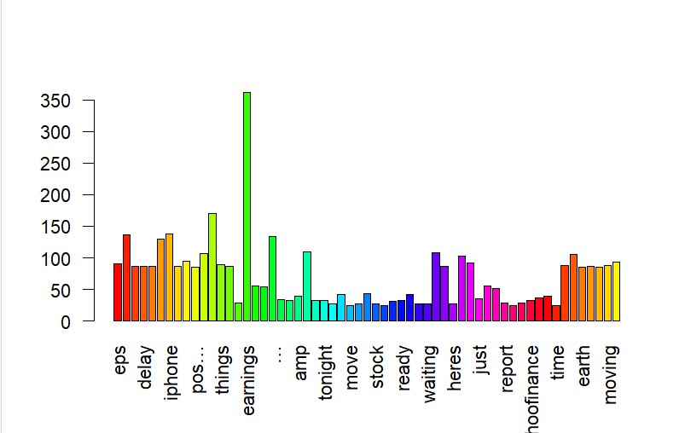
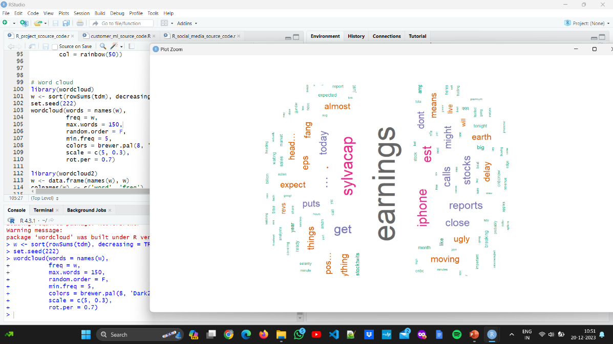
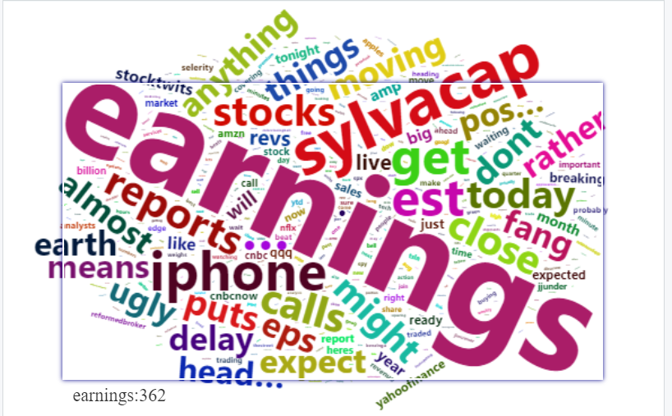

Slide 11
Sentiment Analysis
Setup: The script integrates sentiment analysis tools, leveraging the syuzhet package. It begins by reading the file, converting text using iconv, and extracting sentiment scores with get_nrc_sentiment.
Scores: Sentiment scores are computed for Apple-related tweets, providing an overview of emotional tones present in the text data.
Bar Plot: A bar plot visualizes the sentiment scores, offering a clear depiction of the distribution of sentiments within the Apple-related tweets.
Histogram of Sentiment Distribution: The histogram visually represents the distribution of sentiment labels (positive/negative) within the Apple-related tweets dataset.

Slide 12
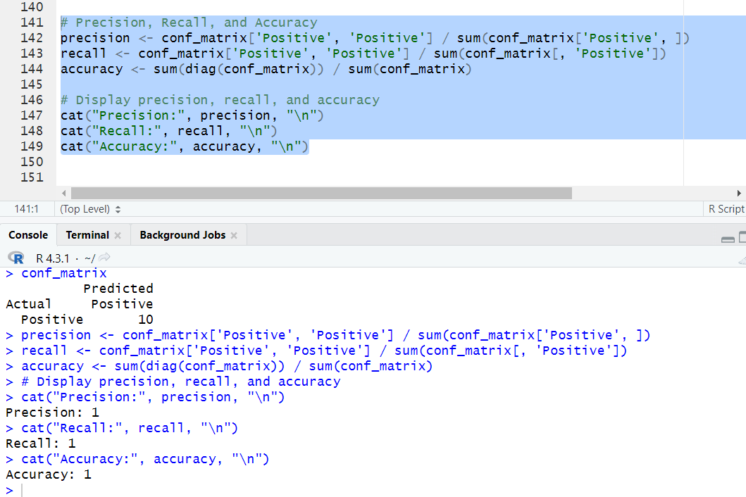
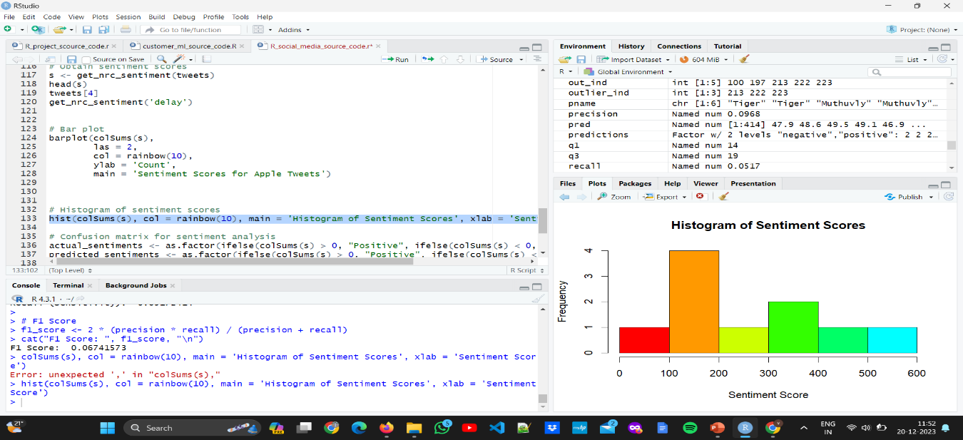
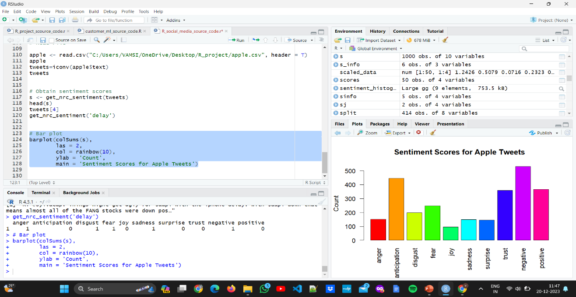

Slide 13
Conclusion
The R code begins by reading Apple-related tweets from a CSV file and then processes the text data. The text cleaning involves converting to lowercase, removing punctuation, numbers, and stop words. A term-document matrix is then created to represent the frequency of terms in the corpus. After further cleaning, the code generates a bar plot and a word cloud to visualize the most frequent terms in the tweets.
The sentiment analysis section involves using the syuzhet library to obtain sentiment scores for each tweet. The code then creates a bar plot to visualize the overall sentiment distribution in the Apple-related tweets.
In summary, this R code provides a comprehensive analysis of sentiment in Apple-related tweets, offering visualizations to enhance the understanding of the data. The libraries used cover a range of functionalities, from text processing to sentiment analysis and data visualization.

Slide 14
SENTIMENT ANALYSIS FOR CUSTOMER REVIEW
USING R LANGUAGE

Slide 15
INTRODUCTION
In this analysis, we delve into the sentiments expressed in Flipkart reviews and conduct text analysis to gain insights into customer feedback.
The goal is to understand the overall sentiment and key aspects highlighted by customers in their reviews.

Slide 16
LIBRARIES
Tidyverse: A collection of packages for data manipulation and visualization in the "tidy" data format.
syuzhet: A package for sentiment analysis that uses the NRC sentiment lexicon.
tidytext: A package for text mining and analysis, especially when working with tidy data principles.
ggplot2: A popular package for creating static graphics in R, used for data visualization.
lubridate: A package for handling date and time data, often used for data preprocessing.
wordcloud: A package for creating word clouds, a visual representation of frequently used words in a text corpus.
wordcloud2:An extension of the wordcloud package, allowing for the creation of interactive word clouds

Slide 17
Sentiment Analysis using syuzhet
In this section, we employ the syuzhet package for sentiment analysis, which is a crucial step in understanding the emotional tone of Flipkart reviews.
Utilizing the NRC (National Research Council) sentiment lexicon, the get_nrc_sentiment function is applied to the review texts to extract sentiment scores for various emotions.
The resulting sentiment scores are aggregated and visualized through a bar plot, showcasing the distribution of different emotions as expressed in the Flipkart reviews.
This analysis provides valuable insights into the emotional context of customer feedback, allowing us to discern prevalent sentiments such as joy, anger, anticipation, and more.
The bar plot serves as a visual representation of the emotional nuances present in the reviews, aiding in the interpretation of customer sentiments towards Flipkart products or services.

Slide 18
Sentiment Analysis using tidytext (bing lexicon)
In this segment, we leverage the tidytext package to perform sentiment analysis using the 'bing' lexicon, which classifies words as either positive or negative.
The unnest_tokens function is employed to tokenize and unnest the text data, creating a word-level data frame.
We then use the inner_join function to associate words with sentiment labels from the 'bing' lexicon, and subsequently, the count function tallies the occurrences of each word sentiment.
Focusing on the top 10 words contributing to each sentiment, we create a bar plot. This visual representation illustrates the relative importance of words in conveying positive or negative sentiments in the Flipkart reviews.
By examining these key words, we gain insights into the language used by customers, allowing us to understand specific aspects that contribute to positive or negative sentiments in their reviews.
This detailed sentiment analysis enhances our understanding of the nuanced sentiments expressed in the Flipkart reviews and provides valuable information for further interpretation and decision-making.

Slide 19
Sentiment Analysis using tidytext (loughranlexicon)
In this section, we employ the tidytext package to conduct sentiment analysis using the 'loughran' lexicon. The 'loughran' lexicon is designed for financial sentiment analysis and categorizes words into different financial sentiments.
The process begins with tokenization and unnesting of the text data using the unnest_tokens function, creating a word-level data frame.
The inner_join function is then utilized to associate words with sentiment labels from the 'loughran' lexicon, and the count function tallies the occurrences of each word sentiment.
Focusing on the top 10 words contributing to each sentiment, we generate a bar plot. This visualization illustrates the relative importance of words in conveying specific financial sentiments in the context of Flipkart reviews.
Analyzing these key words provides insights into the financial language used by customers, offering a nuanced perspective on sentiments related to financial aspects in the reviews.
The detailed sentiment analysis based on the 'loughran' lexicon enriches our understanding of how financial sentiments are expressed in Flipkart reviews, providing valuable information for stakeholders and decision-makers.

Slide 20
Text Analysis
In the text analysis phase, we delve into the Flipkart reviews to extract meaningful insights from the textual data.The process begins with lowercasing the text, removing punctuation, and eliminating numbers to ensure consistency and focus on the actual content of the reviews.
Stop words, common words that do not carry significant meaning, are removed using the removeWords function from the 'tm' package.
To create a comprehensive representation of the text data, we utilize the Term Document Matrix (TDM). The TDM captures the frequency of terms (words) in the corpus of reviews, providing a structured and quantitative view of the language used by customers.
Bar plots are employed to visualize the most frequent terms, offering a quick overview of the key words and phrases that stand out in the reviews.
Additionally, word clouds are generated to present a visually appealing representation of the most frequently occurring words. Larger and bolder words in the cloud indicate higher frequency, offering an intuitive snapshot of the prominent themes within the reviews.
Term Document Matrix, bar plots, and word clouds provides a comprehensive and multi-faceted approach to understanding the textual content and themes within the Flipkart reviews. It aids in uncovering patterns, trends, and common language used by customers, facilitating a more nuanced interpretation of their sentiments and feedback.

Slide 21
Sentiment Analysis of Flipkart Reviews
To discern the sentiment expressed in Flipkart reviews, we employ the syuzhet package, a valuable tool for sentiment analysis in R.The analysis begins by reading the Flipkart reviews and extracting the relevant text data.We use the get_nrc_sentiment function from the syuzhet package to obtain sentiment scores for each review.
This function assigns scores based on the NRC (National Research Council) sentiment lexicon, which categorizes words into various emotional categories.The resulting sentiment scores provide a quantitative measure of sentiments such as joy, anger, fear, and more within each review, offering a nuanced understanding of the emotional tone.
To visualize the sentiment distribution, a bar plot is generated using the barplot function. This plot illustrates the count of sentiments across all reviews, providing an overview of the prevalent emotional tones expressed by customers.
The bar plot serves as a valuable tool for quick interpretation, allowing stakeholders to grasp the overall sentiment distribution in Flipkart reviews efficiently.
This sentiment analysis not only reveals the prevailing sentiments in customer feedback but also enables a more data-driven and insightful exploration of the emotional aspects associated with the Flipkart user experience.

Slide 22
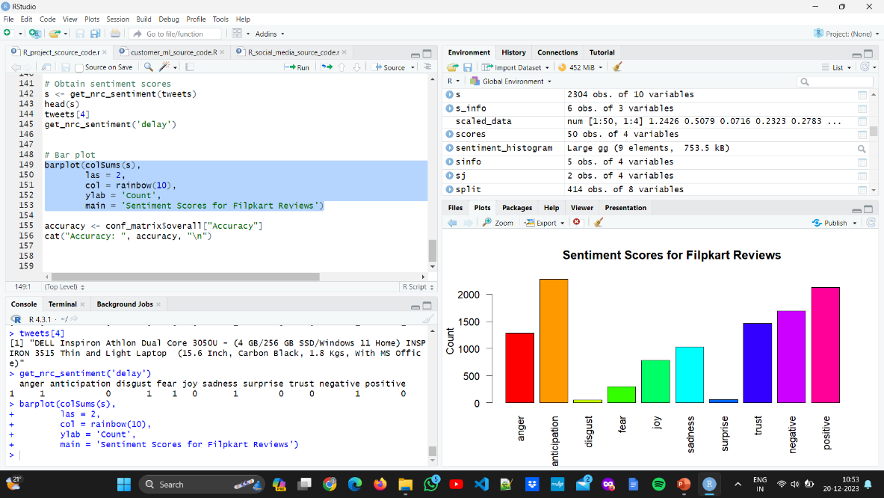
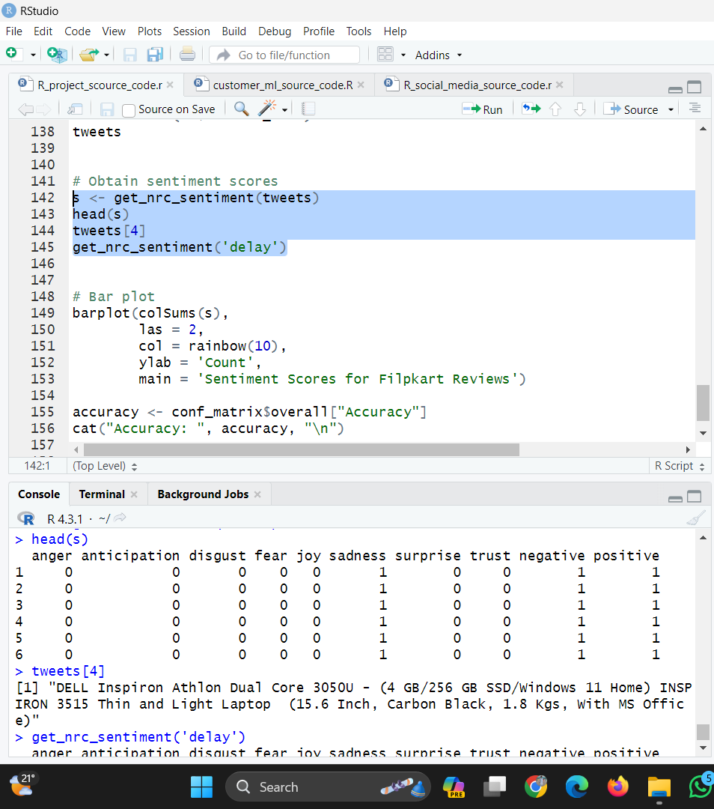
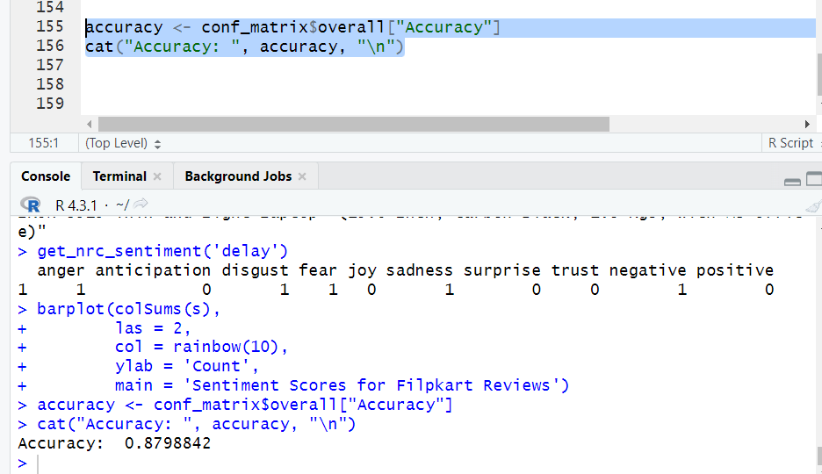

Slide 23
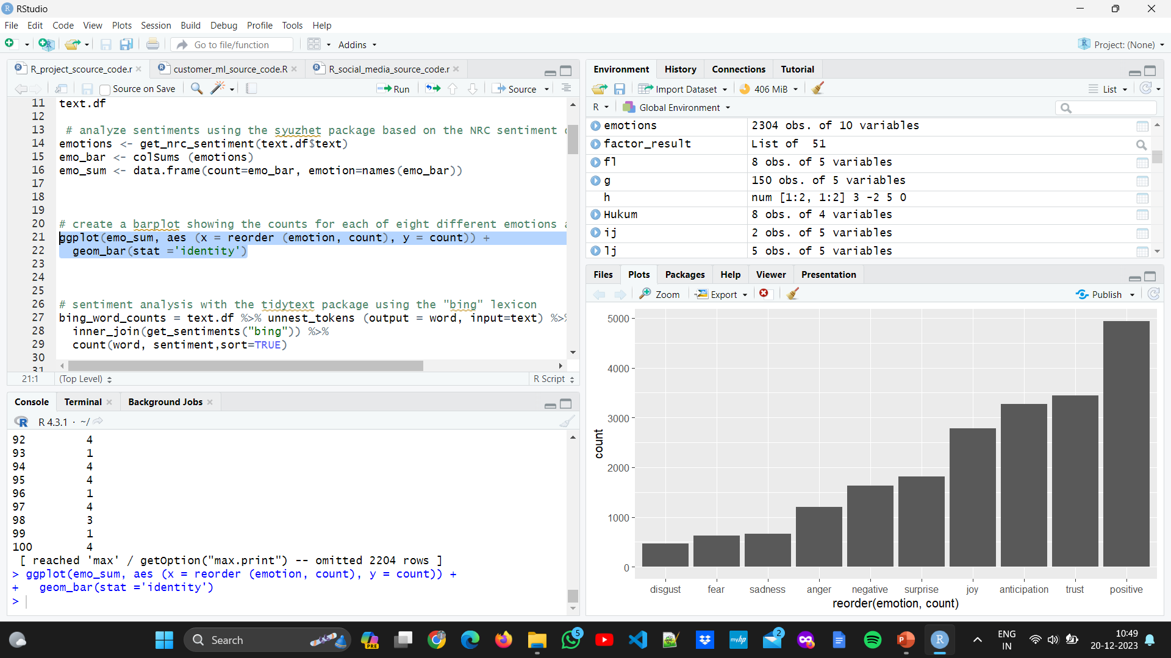
Results - Bar Plot
The bar plot illustrates a visual representation of the results obtained from the sentiment analysis and text mining conducted on Flipkart reviews.Each bar in the plot corresponds to a specific sentiment or term, showcasing the distribution and frequency of sentiments or words across the reviews.The height of each bar reflects the count allowing for a quick and intuitive understanding of the most prevalent aspects identified in the analysis.

Slide 24
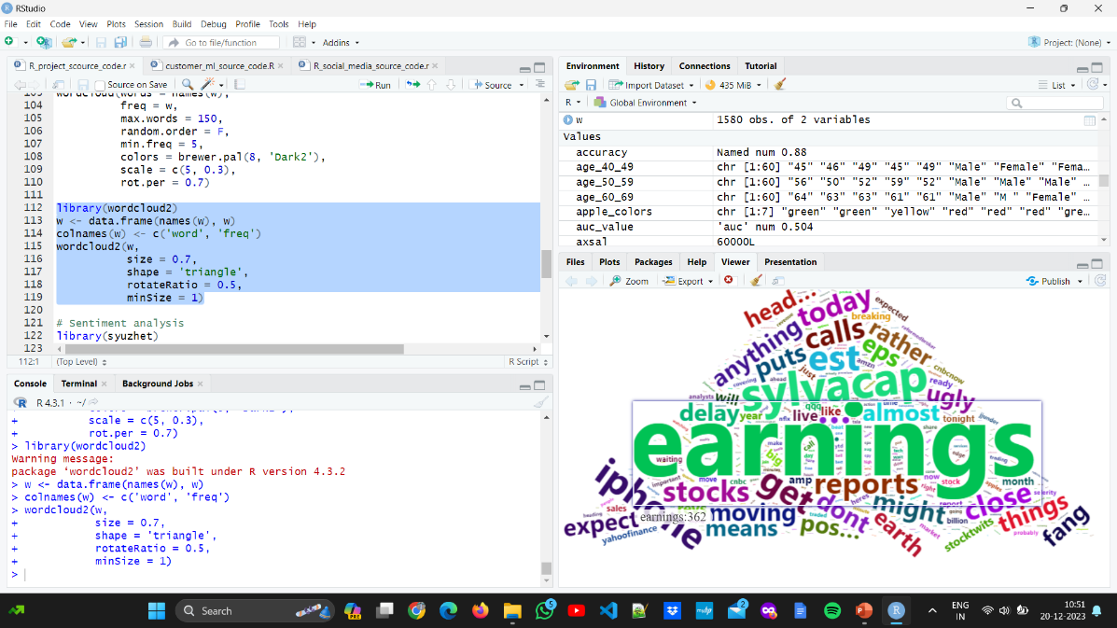
Results - Word Cloud
The word cloud visually presents a compilation of prominent words derived from the Flipkart reviews.
Larger and bolder words in the cloud indicate higher frequency and significance within the dataset.
This visualization enhances the interpretability of the analysis results, providing a snapshot of the language and sentiments expressed by customers on Flipkart.

Slide 25
CONCLUSION
The analysis of Flipkart reviews revealed valuable insights into customer sentiments and prevalent themes.
Utilizing sentiment analysis and text mining techniques, we identified emotional nuances, key positive and negative terms, and recurring themes.
The visualizations, including bar plots and word clouds, provided a clear and concise overview of the findings.
This comprehensive approach enhances decision-making for improving customer satisfaction on the Flipkart platform.

Slide 26
SENTIMENT ANALYSIS FOR CUSTOMER REVIEW
USING MACHINE LEARNING

Slide 27
Introduction
This analysis focuses on sentiment classification of Flipkart reviews using a Support Vector Machine (SVM) model. Leveraging the syuzhet and caret packages in R, the study aims to predict sentiments (positive/negative) based on textual content.
The SVM model is trained on preprocessed data, and its performance is evaluated to gain insights into sentiment distribution.

Slide 28
Libraries
tidyverse: Comprehensive data manipulation and visualization toolkit.
syuzhet: Specialized for sentiment analysis, extracting sentiment scores from text.
caret: Unified framework for training and evaluating machine learning models.
e1071: Extension of SVM for statistical learning, classification, and regression.
tm(Text Mining): Essential for text mining tasks, including corpus creation and manipulation.

Slide 29
Dataset Overview
The dataset, sourced from Flipkart reviews, provides textual feedback.
Initial exploration includes loading the dataset, converting text to lowercase, and creating a tibble for efficient handling.
The subsequent sentiment labeling is carried out using the syuzhet package to determine positive or negative sentiments.

Slide 30
Sentiment Labeling
Sentiments are labeled as "positive" or "negative" based on the difference between positive and negative emotion scores obtained using the syuzhet package.
The resulting sentiment labels are crucial for training and evaluating the SVM model.

Slide 31
Data Preprocessing
Data preprocessing involves a series of steps including:
text cleaning functions to convert text to lowercase,
remove special characters, numbers, and punctuation.
The cleaned text is then used for further analysis, enhancing the quality of input data.

Slide 32
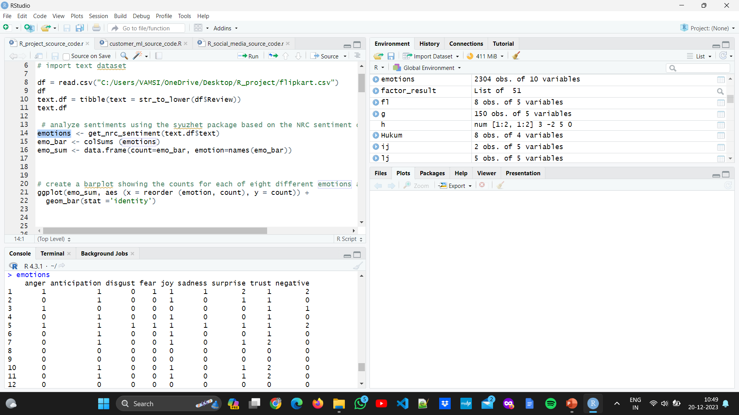
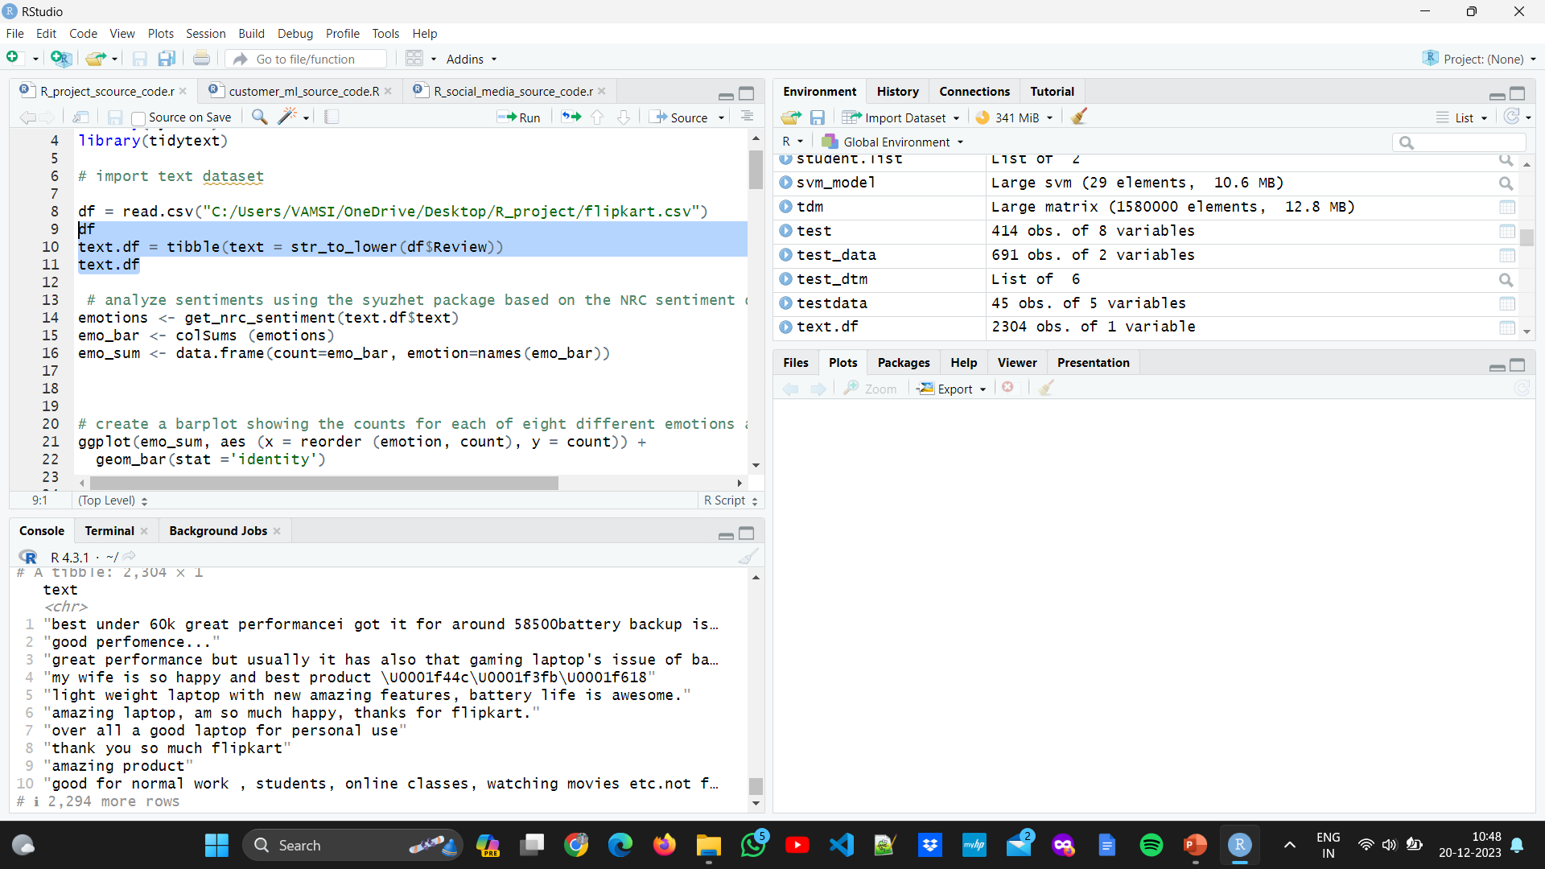

Slide 33
Train-Test Split
The dataset is divided into training and testing sets using the caret package's createDataPartition function.
This ensures the model is trained on a subset of the data and evaluated on an independent subset, providing a robust assessment of model performance.

Slide 34
Feature Extracton:
Feature extraction involves tokenization of text data and the creation of a Document-Term Matrix (DTM) to represent the frequency of words in the dataset. This matrix serves as input for training the SVM model.

Slide 35
SVM Model Training
The SVM model is trained using the svm function from the e1071 package. The model is fed the Document-Term Matrix created from the training set's tokenized text features.

Slide 36
Model Evaluation:
The trained SVM model is evaluated on the testing set, and performance metrics such as accuracy, ROC curve, AUC, precision, recall, and F1 score are calculated.
The confusion matrix provides a detailed overview of model predictions.

Slide 37
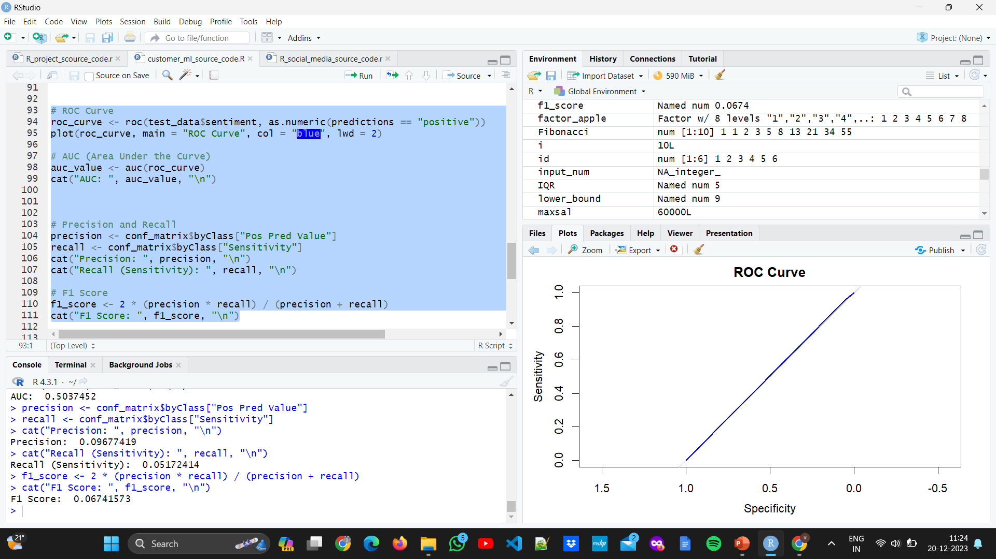

Slide 38
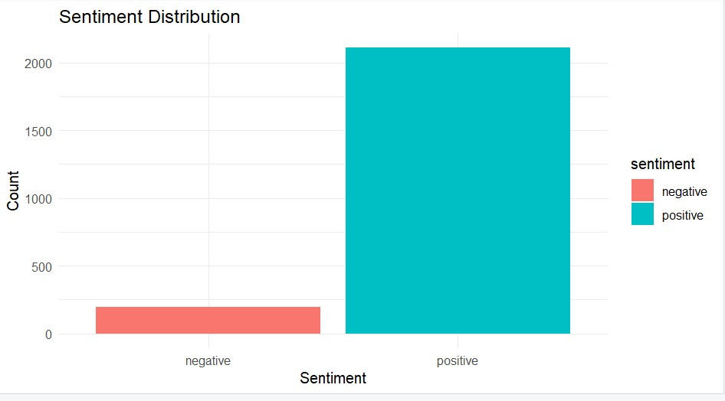
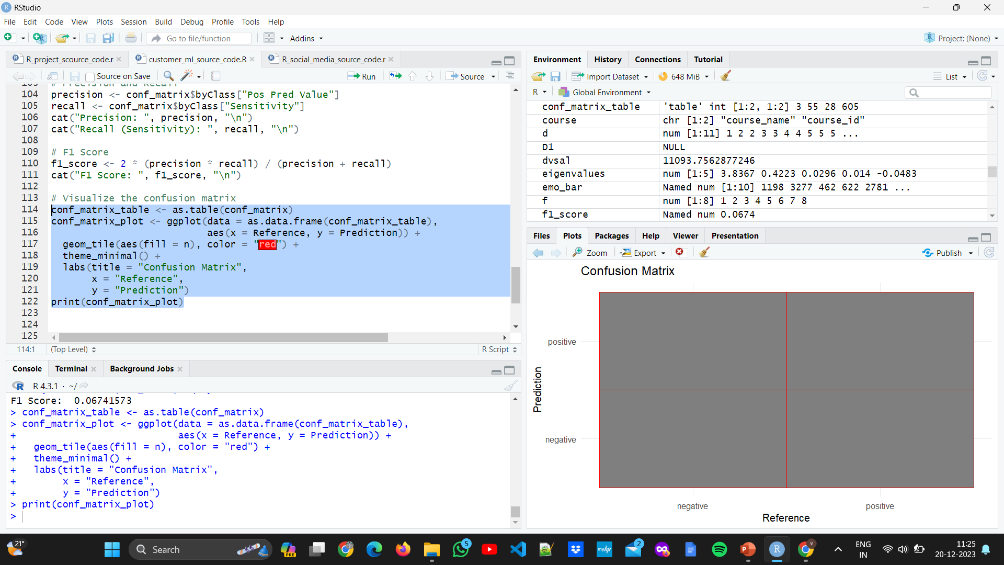
Output

Slide 39
Conclusion
This analysis demonstrates the application of an SVM model for sentiment classification in Flipkart reviews. Through comprehensive preprocessing, model training, and evaluation, the study provides insights into sentiment distribution and model performance, offering a foundation for further refinement and application in customer feedback analysis.

Slide 40
THANK YOU

